Slide 1
APUSH Review: Booker T. Washington and W.E.B. DuBois
Everything You Need To Know About Booker T. Washington and W.E.B. Du Bois To Succeed In APUSH

Slide 2
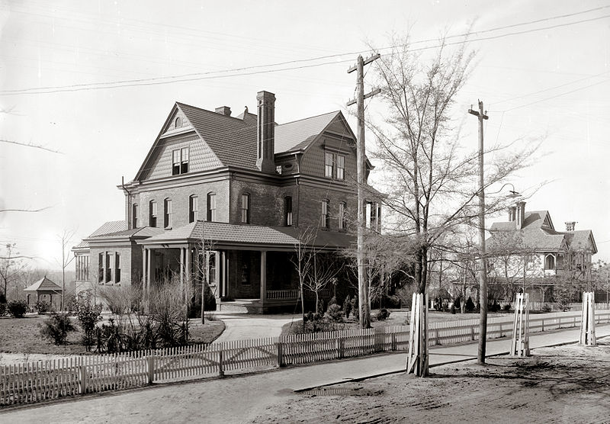
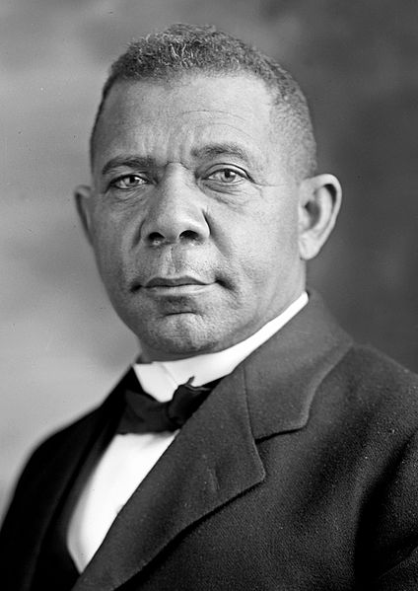
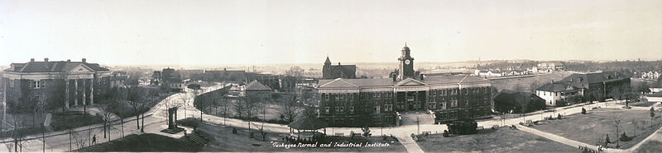
Background on Booker T.
Born in 1856, in Virginia, as a slave
Established the Tuskegee Institute in Alabama
Believed that education was very important for African Americans
Vocational training – learning a specific skill
The Atlanta Compromise (1895):
Belief that African Americans should accept segregation in exchange for economic opportunities
“In all things that are purely social we can be as separate as the fingers, yet one as the hand in all things essential to mutual progress.”

Slide 3
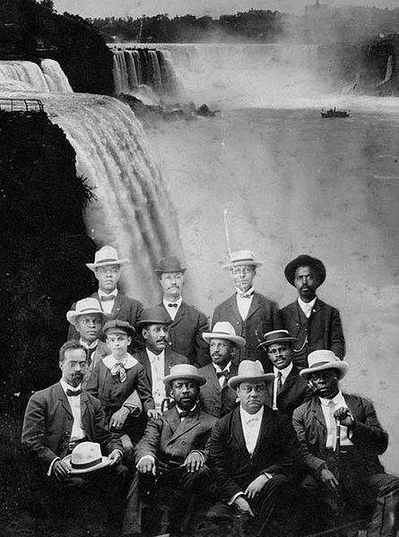
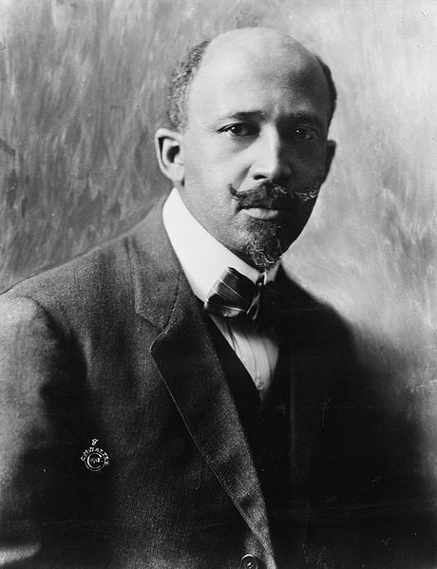
Background on W.E.B.
Born in 1868 in Massachusetts
Received a doctorate from Harvard
Opposed Booker T.’s accommodation policies
Niagara Movement (1905):
Niagara Falls, Canada
Wanted an end to discrimination and segregation
Helped morph into….
NAACP
Goal is to ensure equality and end discrimination
Talented Tenth
Leaders in the African American community should have full access to education and American life

Slide 4
Comparing The Two
Both wanted rights for African Americans
Two of the most influential African Americans from the late 19th, early 20th century
They differed on how to achieve those rights
W.E.B. was against accommodation and segregation
Gradual acceptance – Booker T.
Immediate acceptance – W.E.B.

Slide 5
Test Tips
Essay Topics:
Often comparing leaders from times
Ex. How did Booker T. and W.E.B. compare to MLK and Malcom X
Tips for Multiple-Choice questions:
Booker T.:
Favored vocational training
Be able to identify “In all things that are purely social we can be as separate as the fingers, yet one as the hand in all things essential to mutual progress.”
W.E.B.:
NAACP, Niagara Movement, and the talented 10th
Good Luck!

Slide 6
Thanks for watching!
Subscribe to my channel
Help spread the word
Questions? Comments? Ideas for videos?
Leave in comments
Subscribe
Down here!

